Slide 1
Dynamic Programming
used some slides from
https://www.cis.upenn.edu/~matuszek/
cit594-2014/Lectures/30-dynamic- programming.ppt
http://web.stanford.edu/class/cs97si/

Slide 2
Logistics
Will be taking over from Dr. Ahmed
For the rest of classes
Except this Wednesday (for midterm)
Myself
Prof. Sherief Abdallah, PhD UMASS Amherst, USA
Expertise in AI and Agents (starting 1998, before they were cool ☺)
Love programming and algorithms
Also program coordinator (organizing CS modules)

Slide 3
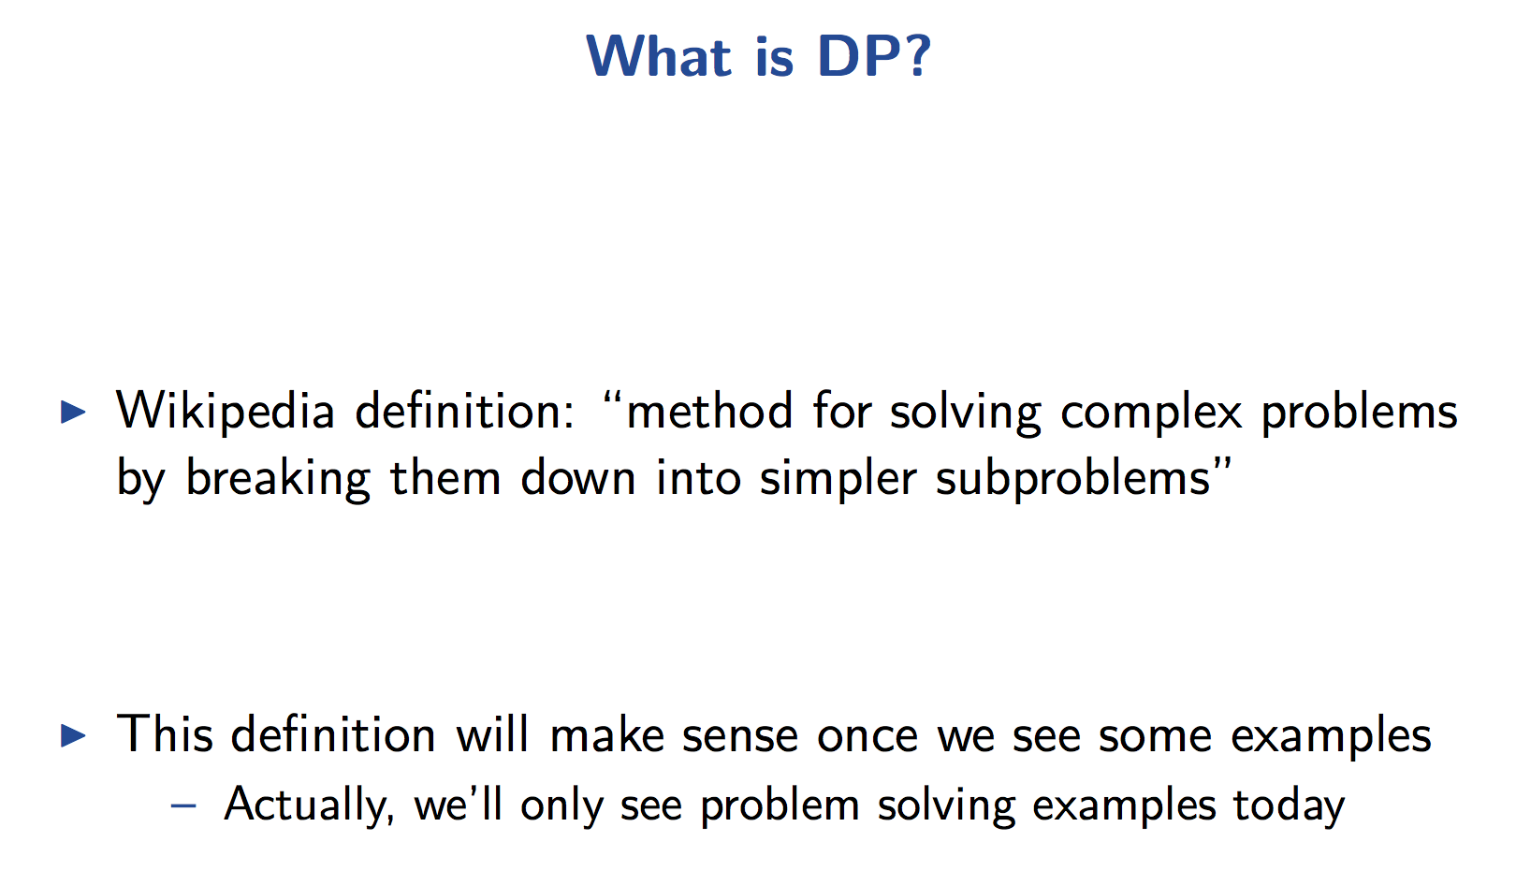
Dynamic Programming (DP)

Slide 4
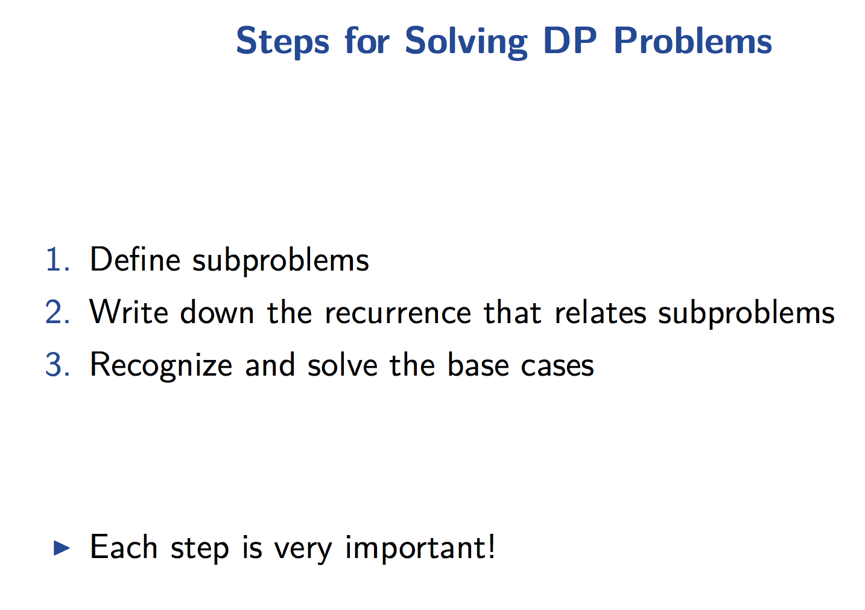

Slide 5
Dynamic Programming
Very powerful
general tool for solving optimization problems.
Once understood it is relatively easy to apply
but many people have trouble understanding it.

Slide 6
Greedy Algorithms
Focus on making best local choice at each decision point
Example dijkstra
But greedy algorithms are (usually) not optimal
Because you only consider immediate decision (not overall)

Slide 7
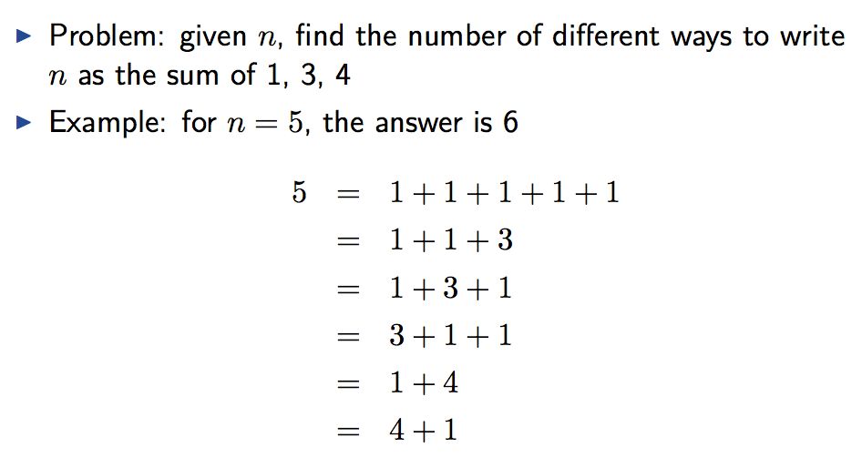

Group Exercise
Break into groups, think about solution
recursion?
What is the time complexity?

Slide 8
What is dynamic programming?

Slide 9
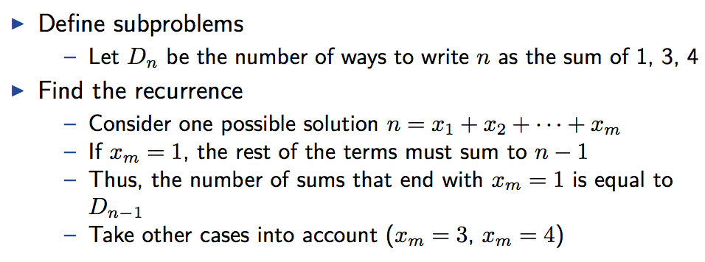
1-dimensional DP Problem

Slide 10
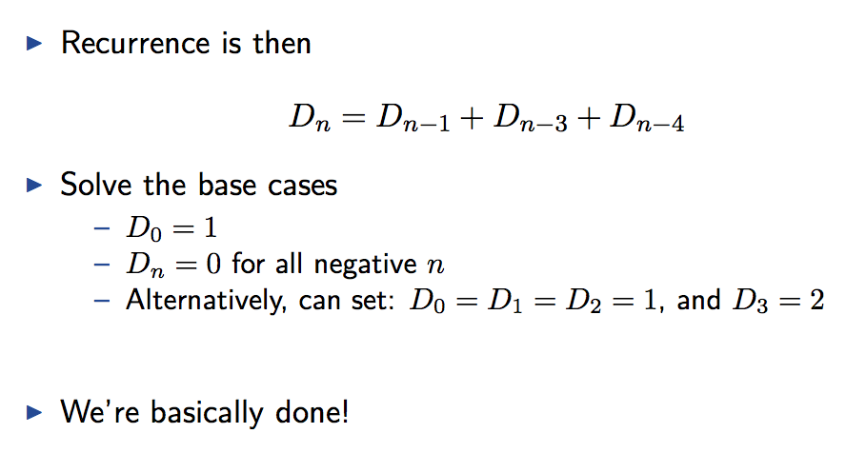
1-dimensional DP Problem
Using naive recursion is wasteful, why? → draw recursion tree

Slide 11
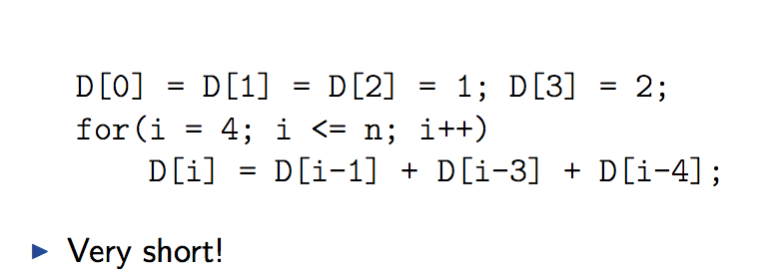
1-dimensional DP Problem
Recursion is wasteful
because many subproblems repeat
We can replace recursion with loops
Ensuring every subproblem solved once

Slide 12
Dynamic programming
Main approach
recursive, holds answers to a sub problem in a table
can be used without recomputing.
Can use recursion and save results in a table (memoization)
Typically, we first formulate the recursive solution and then turn it into recursion plus dynamic programming via memoization or bottom-up.
”programming” as in tabular
not programming code

Slide 13
Let Us Code
Naïve recursion
With memorization
And table solution

Slide 14
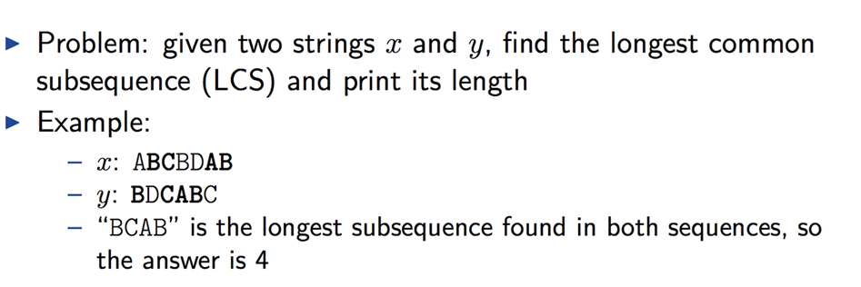
2-dimensional example

Slide 15
Problem: Given 2 sequences, X = ⟨x₁,...,x_{m}⟩ and Y = ⟨y₁,...,y_{n}⟩, find a common subsequence whose length is maximum.
springtime ncaa tournament basketball
printing north carolina snoeyink
Subsequence need not be consecutive, but must be in order.
How to solve it, naivly?

Slide 16


Slide 17
Group Exercise
Break into groups
think about solution
Think of recursion
How to break problem
Analyze time complexity

Slide 18
How to solve it? Start with example
c[springtime, printing]
c[springtim, printing] c[springtime, printin]
[springti, printing] [springtim, printin] [springtim, printin] [springtime, printi]
[springt, printing] [springti, printin] [springtim, printi] [springtime, print]
Recursion & optimal substructure

Slide 19
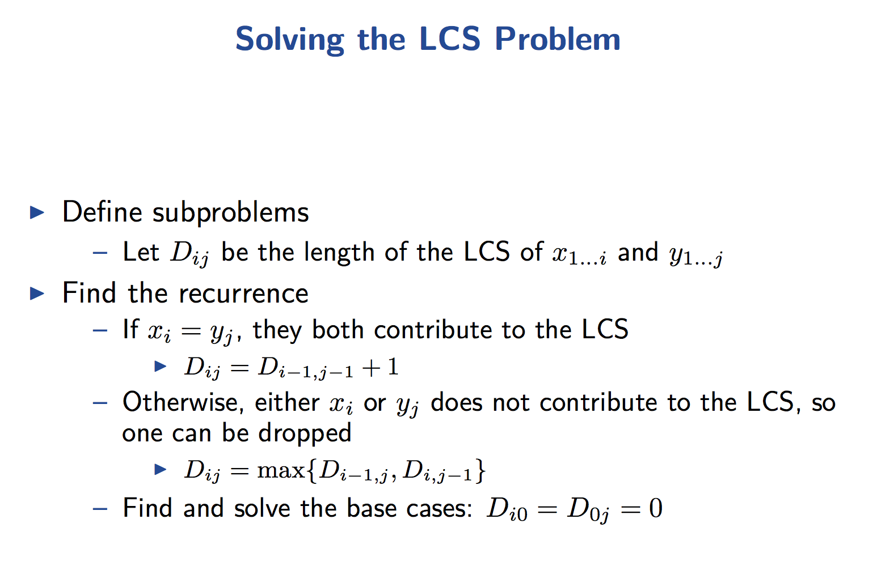

Slide 20
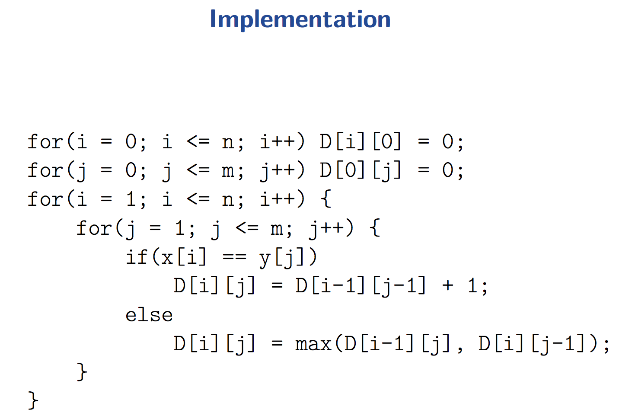
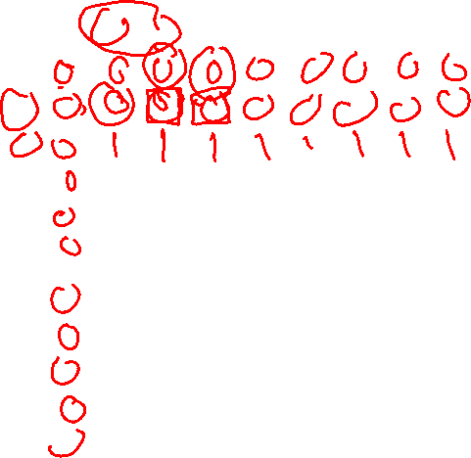
 |  | p | r | i | n | t | i | n | g
s
p
r
i
n
g
t
i
m
e
Let us follow algorithm and fill the table →
This matrix computes the length of the LCS, but how to return sequence itself?
Follow the max
Keep track of parent

Slide 21
Animation
https://www.cs.usfca.edu/~galles/visualization/DPLCS.html

Slide 22
Let us have a fresh stab
Will go over all problems so far
Try to identify the connecting pattern

Slide 23
1- Initial problem
The initial problem
Think of it as the input to the recursion
If possible, to simplify, we only want integers
Longest common sequence
Two (sub)strings
To simplify, we only use the indices to represent (sub)string

Slide 25
2- Options (to break the problem to subproblems)
Different ways/actions/options
To progress and solve the problem using subproblems
Think of the next recursion call
Longest common sequence
2 last chars same → skip 1 char from each string → new state is two substring shorter
Different last chars → two options: skip char from String 1, or skip char from String 2

Slide 27
3-Result
The answer we are looking for
We should be able to write a recursive equation using steps 1+2
Longest common sequence?
Decomposing number to 1,3,4?

Slide 28
Exercise: Rod cutting problem
Given
a rod of size n
And prices p of rods of size 1,2,3…n
What is the optimal way to cut rod and maximize profit?
Example
n = 10, p[1]=1, p[2]=3,p[3]=4,p[6]=10, p[else]=0

Slide 30
Spelling checker
User enters a wrong word
Not in dictionary
How to suggest/recommend "closest" word?
Rank words on dictionary
How to "measure" difference between words?

Slide 31
Spelling Checker (Cont.)
Input
word (to be matched)
Dictionary (list of words to match)
Output
Top 10 words from dictionary
Ranked from most similar to least
Match is not exact

Slide 32
Very important subproblem: Edit distance
Input
Word to match (may contain errors)
Word from dictionary
Output
minimum number of edit operations to convert one string to another
Edit operations
D = Delete char from first string
I = Insert char in first string
R = replace a char from first string with char in second string
M = match char in the first string with a char of the second
p.s. same problem applies to matching gene sequences

Slide 33
Example: transform vintner to writers
vintner replace v with w --> wintner
wintner insert r after w --> wrintner
wrintner match i --> wrintner
wrintner delete n --> writner
writner match t --> writner
writner delete n --> writer
writer match e --> writer
writer match r --> writer
writer insert s --> writers
Edit distance = 1+1+1+1+1+1+1 +1 + 1 = 9 operations
Here we assume all operations have same cost
But they can be different and solutions largely the same

Slide 34
Thinking Time: How to solve Edit distance?
Input
Word to match (may contain errors)
Word from dictionary
Output
minimum number of edit operations to convert one string to another
Edit operations
D = Delete char from first string
I = Insert char in first string
R = replace a char from first string with char in second string
M = match char in the first string with a char of the second.
Recall
State → options → Recurrence

Slide 35
draw branching/recursive tree
EditDistance(int I, int j ) =
if I = s1.length return (s2.length – j) * costI
Else if j = s2.length return (s1.length – i) * costD
if(s1[i] ==s2[j]) result=EditDistance( i+1, j+1)
Else result = min(costD + EditDistance(i+1,j) , costI + editDistance(I,j+1), costR+EditDistance( i+1, j+1)
Return result;

Slide 36
The recurrence
$$ed\left(i,j\right)=\left\{\begin{aligned}min\left(c\left(D\right)+ed\left(i+1,j\right),c\left(I\right)+ed\left(i+1,j+1\right),c\left(R\right)+ed\left(i+1,j+1\right)\right),ifs1\left[i\right]≠s2\left[j\right] \\ ed\left(i+1,j+1\right),ifs1\left[i\right]=s2\left[j\right] \\ c\left(D\right)length\left(s1\right)ifj=length\left(s2\right) \\ c\left(I\right)length\left(s2\right),ifi=length\left(s1\right)\end{aligned}\right.$$
Make recursive algorithm
With memorization
Make bottom up algorithm
With matrix fill-up
What is the complexity?

Slide 37
Going back to the spelling checker
Input
word (to be matched)
Dictionary (list of words to match)
Output
Top 10 words from dictionary
Ranked from most similar to least
Match is not exact
What is the complexity?

Slide 38
Dynamic programming 3

Slide 39
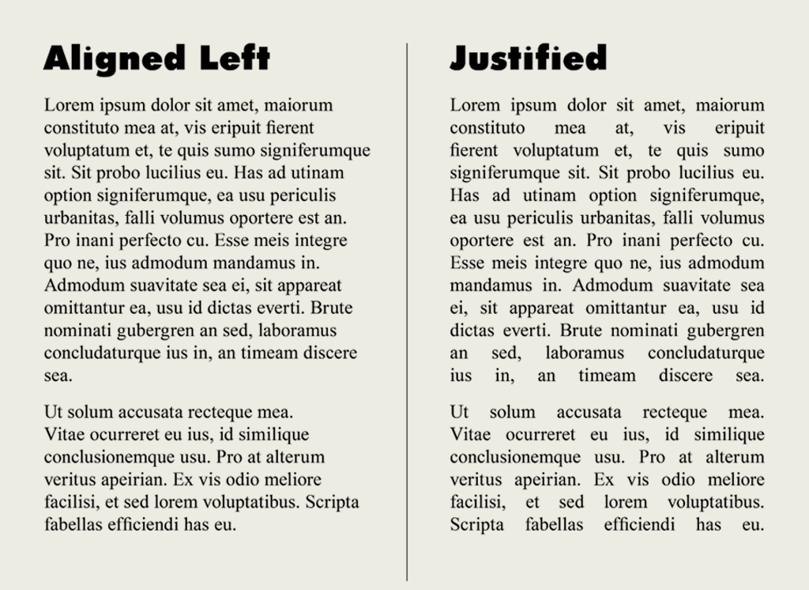
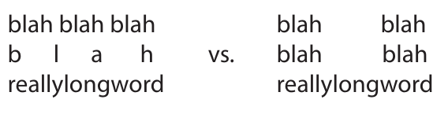
Another problem: Text Justification
Split text into “good” lines
What is “good”?
Not bad!
Greedy approach?
Fit as many words as possible in current line
Algorithm? Complexity?
Which one of below is greedy?
Which is better?

Slide 40
New problem: Text Justification
One possible measure of line badness =
(page width – text width)³
Need to minimize overall badness
for all lines
Thinking time
How to solve using Dyn. Prog.? Problem input, options, recurrence

Slide 41
draw branching/recursive tree

Slide 42
Solution
Input
Words, from i onwards
Options
Where to break next line, j
Recurrence
tj[i] = min(badness (i, j) + tj[j] for j in range (i + 1, n + 1))
Base case: tj[n] = 0
Algorithm
Iterative vs memoization
Complexity
O(n2)
Why?

Slide 43
Coin-change Problem
To find the minimum number of Canadian coins to make any amount, the greedy method always works.
At each step select the largest denomination not going over the desired amount.

Slide 44
Coin-change Problem
The greedy method doesn’t work if we didn’t have 5¢ coin.
For 31¢, the greedy solution is 25 +1+1+1+1+1+1
But we can do it with 10+10+10+1
The greedy method also wouldn’t work if we had a 21¢ coin
For 63¢, the greedy solution is 25+25+10+1+1+1
But we can do it with 21+21+21

Slide 45
Coin set for examples
For the following examples, we will assume coins in the following denominations: 1¢ 5¢ 10¢ 21¢ 25¢
We’ll use 63¢ as our goal

Slide 46
A solution
We can reduce the problem recursively by choosing the first coin, and solving for the amount that is left
For 63¢:
One 1¢ coin plus the best solution for 62¢
One 5¢ coin plus the best solution for 58¢
One 10¢ coin plus the best solution for 53¢
One 21¢ coin plus the best solution for 42¢
One 25¢ coin plus the best solution for 38¢
Choose the best solution from among the 5 given above
We solve 5 recursive problems.
This is a very expensive algorithm

Slide 47
A dynamic programming solution
Idea: Solve first for one cent, then two cents, then three cents, etc., up to the desired amount
Save each answer in an array !
For each new amount N, combine a selected pairs of previous answers which sum to N
For example, to find the solution for 13¢,
First, solve for all of 1¢, 2¢, 3¢, ..., 12¢
Next, choose the best solution among:
Solution for 1¢ + solution for 12¢
Solution for 5¢ + solution for 8¢
Solution for 10¢ + solution for 3¢

Slide 48
A dynamic programming solution
Let T(n) be the number of coins taken to dispense n¢.
The recurrence relation
T(n) = min {T(n-1), T(n-5), T(n-10), T(n-25)} + 1, n ≥ 26
T(c) is known for n ≤ 25
It is exponential if we are not careful.
The bottom-up approach is the best.
Memoization idea also can be used.

Slide 49
A dynamic programming solution
The dynamic programming algorithm is O(N*K) where N is the desired amount and K is the number of different kind of coins.

Slide 50
Illustrative animation
https://www.cs.usfca.edu/~galles/visualization/DPChange.html

Slide 51
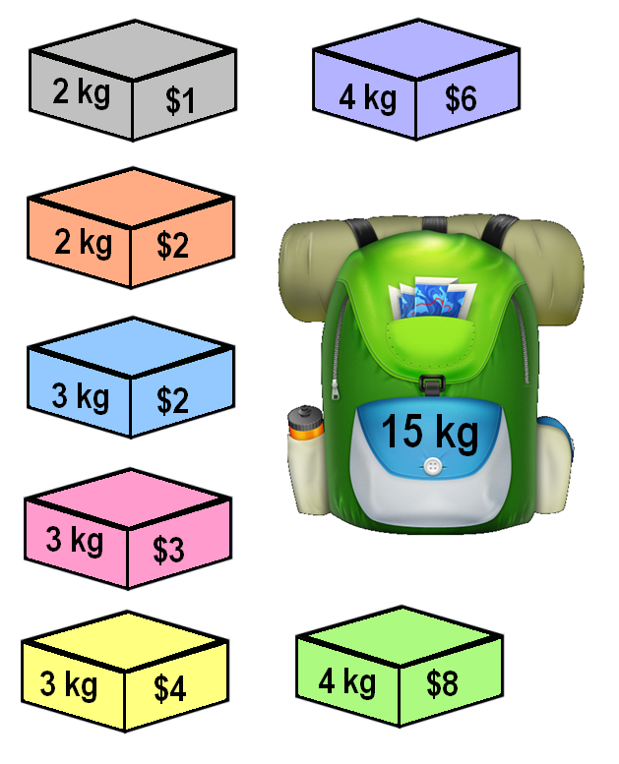
Knapsack Problem
A thief breaks into a house, carrying a knapsack...
He can carry up to W=15 kg
He has to choose which of N=7 items to steal
Value and mass of each item is given
Goal: maximize profit

Slide 52
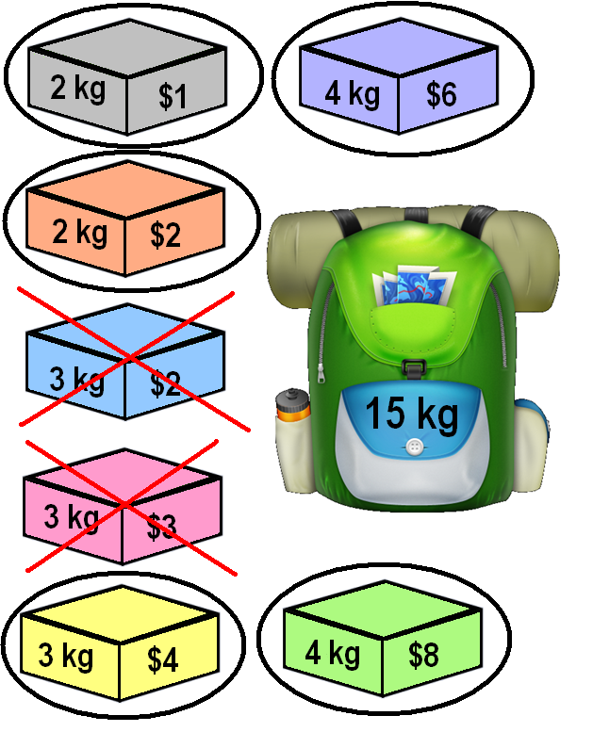
Solution

Slide 53
The 0-1 knapsack problem
A greedy algorithm does not find an optimal solution
Example?
A dynamic programming algorithm works well.

Slide 54
The 0-1 knapsack problem
This is similar to, but not identical to, the coins problem
In the coins problem, we had to make an exact amount of change
In the 0-1 knapsack problem, we can’t exceed the weight limit, but the optimal solution may be less than the weight limit
The dynamic programming solution is similar to that of the coins problem

Slide 55
Smart Kids Write Equations
When an item is placed in the knapsack, a decision, F(W), is made to choose the next optimal item, i.
Recurrence relation:
F(i,W) = max (F(i+1,?) + v_{i}, F(i+1, m))
Base cases:
F(i,0) = ?
Use recursion and iterate through the problem, eventually coming up with the optimal solution.
0,W
Do not include item 0
include item 0
1,W
1,?

Slide 56
Let us write the algorithm
What is the data structure?

Slide 57
Steps for Solving DP Problems
Define subproblems
Write down the recurrence that relates subproblems
Recognize and solve the base cases
Use iterative approach (or memorization) to avoid repeating computations
Each step is very important.

Slide 58
Comments
Dynamic programming relies on working “from the bottom up” and saving the results of solving simpler problems
These solutions to simpler problems are then used to compute the solution to more complex problems
Dynamic programming solutions can often be quite complex and tricky

Slide 59
Comments
Dynamic programming is used for optimization problems, especially ones that would otherwise take exponential time
Only problems that satisfy the principle of optimality are suitable for dynamic programming solutions
Since exponential time is unacceptable for all but the smallest problems, dynamic programming is sometimes essential.

Slide 60
One more Dyn. Prog. Exercise
Last one ☺
Emaary is big real estate company in Dubai. They have a lot of possible real estate projects they can start.
Each project i has budget Bi and profit Ri
Given their overall budget W, help Emaary find the collection of projects that will
Fit the overall budget
Maximize profit

Slide 61
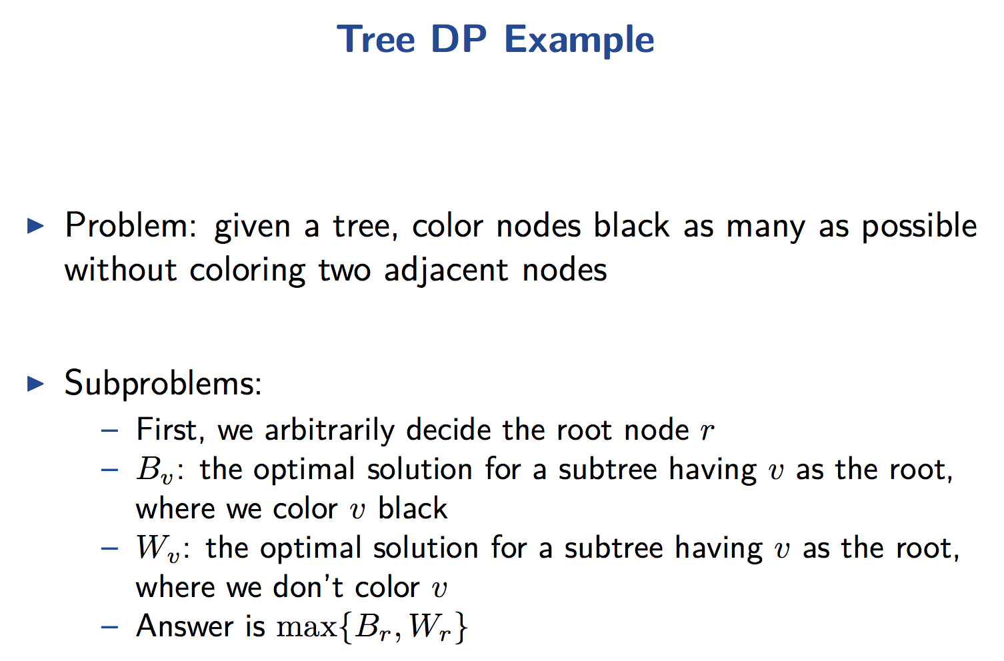
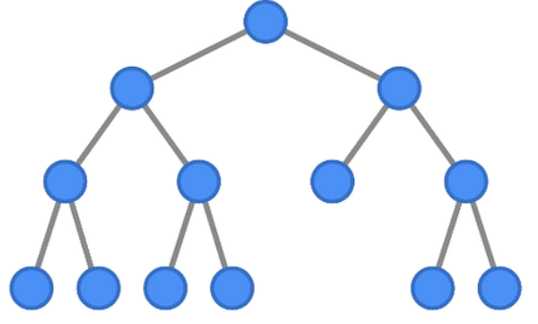
Note that tree does not have to be binary or balanced and you can adjacent uncolored (white)
nodes

Slide 62
Naïve approach
Try all possible colors
Choose one that is valid and yield maximum
Complexity?
Can we use dyn. pro?
What would be the state?
What are the options?
What is the recurrence?

Slide 64
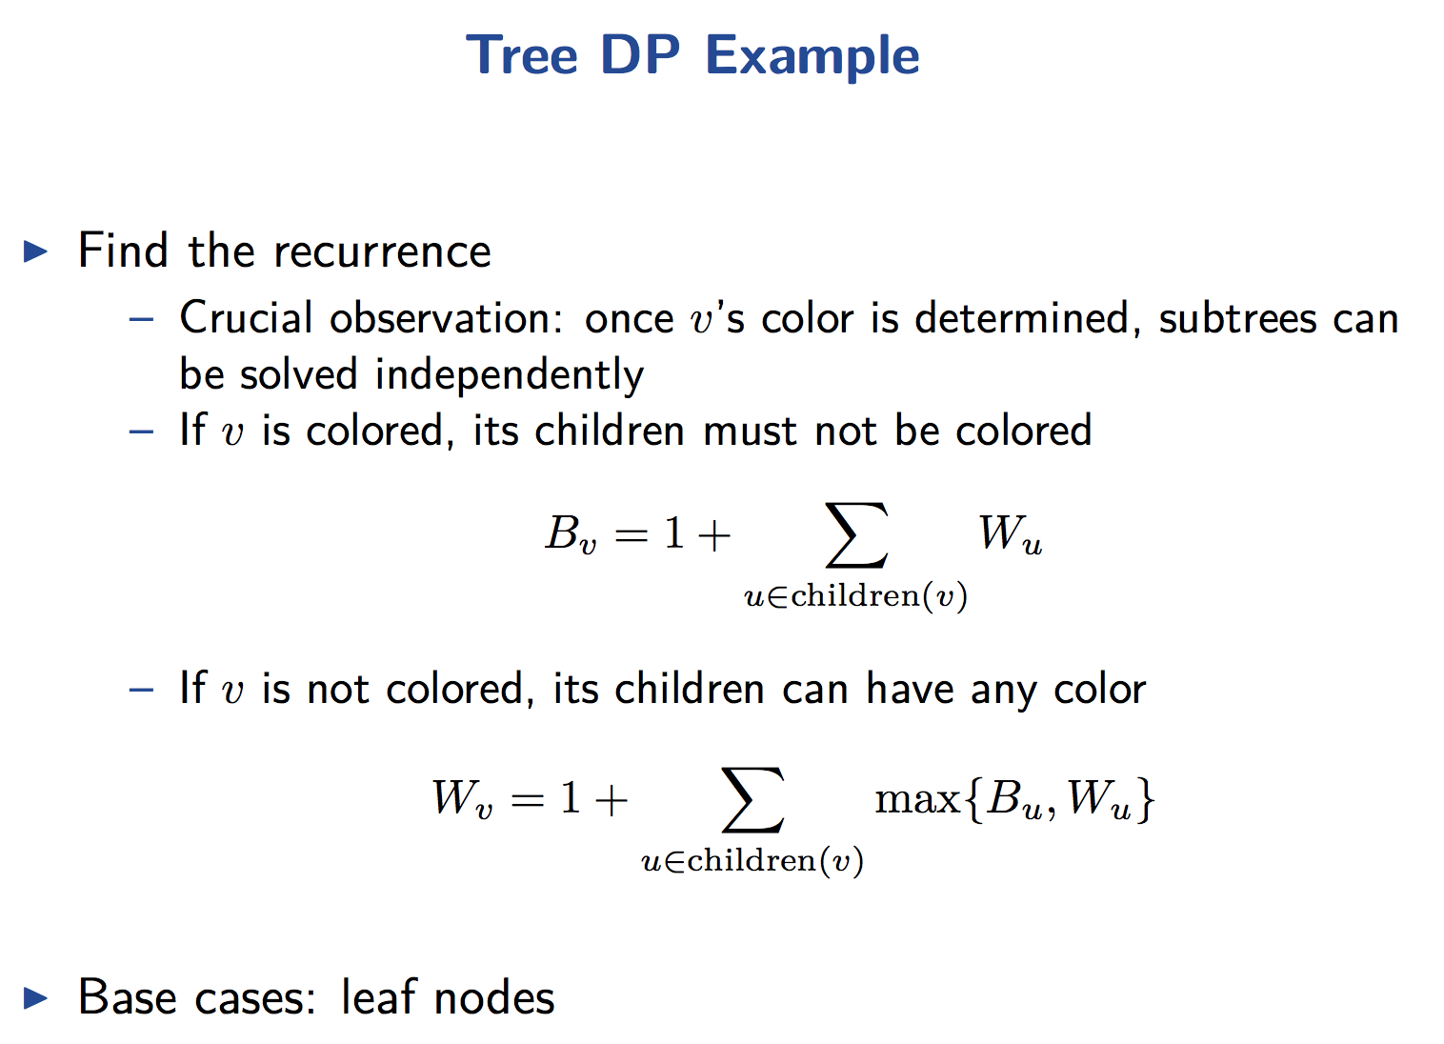

Slide 65
13
12
11
10
9
8
7
6
5
4
3
2
1
 | 1 | 2 | 3 | 4 | 5 | 6 | 7 | 8 | 9 | 10 | 11 | 12 | 13
B
W

Slide 66
13
12
11
10
9
8
7
6
5
4
3
2
1
 | 1 | 2 | 3 | 4 | 5 | 6 | 7 | 8 | 9 | 10 | 11 | 12 | 13
B | 1 | 1 | 1 | 1 | 1 | 1 | 1 | 1 | 1 | 1 | 3 | 5 | 8
W | 0 | 0 | 0 | 0 | 0 | 0 | 2 | 0 | 2 | 2 | 3 | 4 | 8

Slide 67
Group Exercise
We want to design scheduler for BUiD
For creating suitable timetable(s)
Input: modules & program-years
For each module: code, prof_id
For each program-year: list of module codes (to be taught for specific program-year)
Output: Valid module -> timeslot allocation
For each module, choose 1 of 6 slots (MW or TT, 1, 2 or 3)
s.t.
No mods for the same program-year assigned same slot
No mods for same prof. id assigned same slot

Slide 68
Example Input/Output
Input
Modules
ENG103: G1, BUS114-1:B1, ITC101:C1, ARB101/102:G2, CS112:C2, CS212:C3, CS213:C4, CS220:C5, CS333:C6, CS334:C7, CS331: C8, BUS114-2:B1, CSAI411: C5, CSAI414:C6, BUS114-3:B1
Prog. Years
CS-Y1: BUS114-1, ENG103, ITC101, ARB101/102
CS-Y2: CS112, CS212, CS213, CS220
CS-Y3: BUS114-2, CS333, CS334, CS331,
CS-Y4: BUS114-3, CSAI411, CSAI414
Output
Timetable
ENG103: S1, BUS114-1:S2, ITC101:S3, ARB101/102:S4,
CS112:S1, CS212:S2, CS213:S3, CS220:S4,
CS333:S1, CS334:S2, CS331: S3, BUS114-2:S4,
CSAI411: S1, CSAI414:S2, BUS114-3:S3

Slide 69
Group Exercise (cont.)
Can we incorporate preferences?
Student Y from Year 4 needs to re/take module Z from another year
Input: modules & program-years & students
For each module: code, name, prof_id
For each program-year: list of module codes (to be taught for specific program-year)
For each student: list of module codes left for each student
Output: module -> timeslot dict. that is
Valid: for each mod, choose 1 of 6 slots (MW or TT, 1, 2 or 3)
s.t.
No mods for the same program year assigned same slot
No mods for same prof. id assigned same slot
Optimal:
Maximum number of modules taken by students

